Slide 1
Finite Difference Analysis with Matlab®
Specify: Operational Parameters & Physical Properties
Assign: Boundary Conditions & Initial Values
Move Boundary
Solve: Navier-Stokes Equation with ∂P/∂y from Reynolds Equation
Meet the Transition Point
No
Yes
Solve: Navier-Stokes Equation Neglecting ∂P/∂y
Reach Numerically Convergent Steady State
Obtain: Velocity Field & Penetration Distance
Finite Element Analysis with ABAQUS®
Specify: Thermal Properties & Operational Parameters
Conduct: Uncoupled Heat Transfer Analysis
Obtain: Temperature Distribution Near Tool Tip

Slide 2
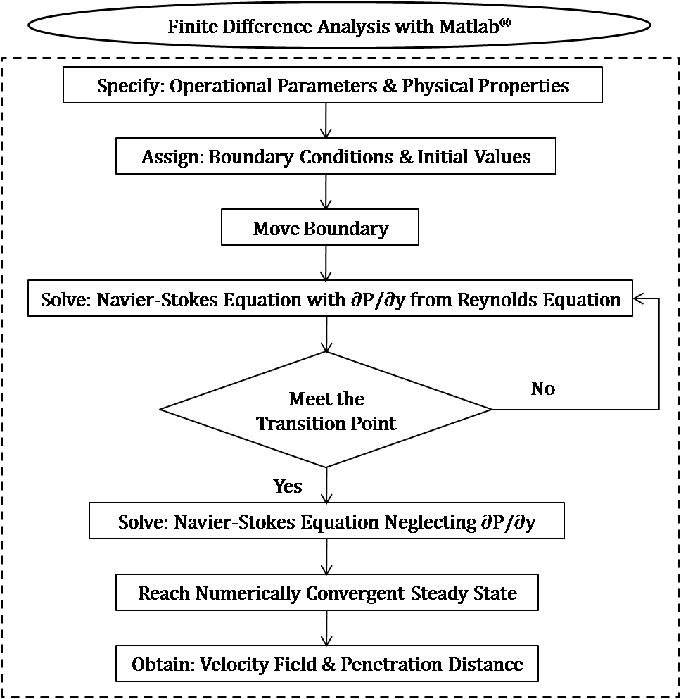
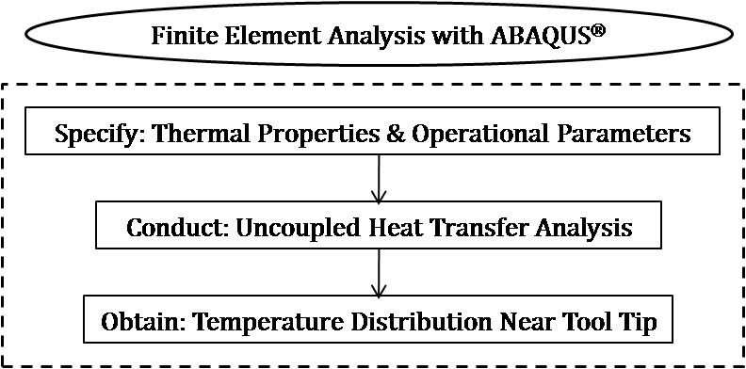
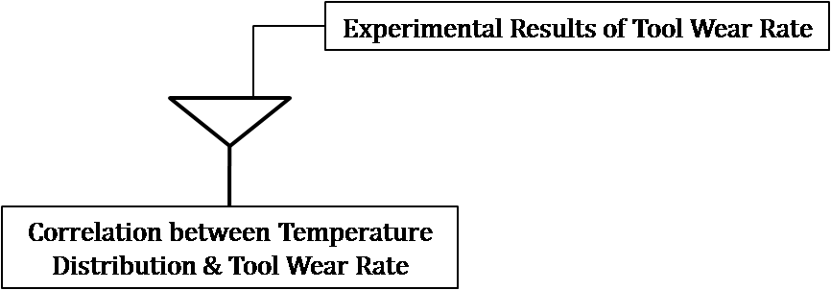
Experimental Results of Tool Wear Rate
Correlation between Temperature Distribution & Tool Wear Rate

Slide 3
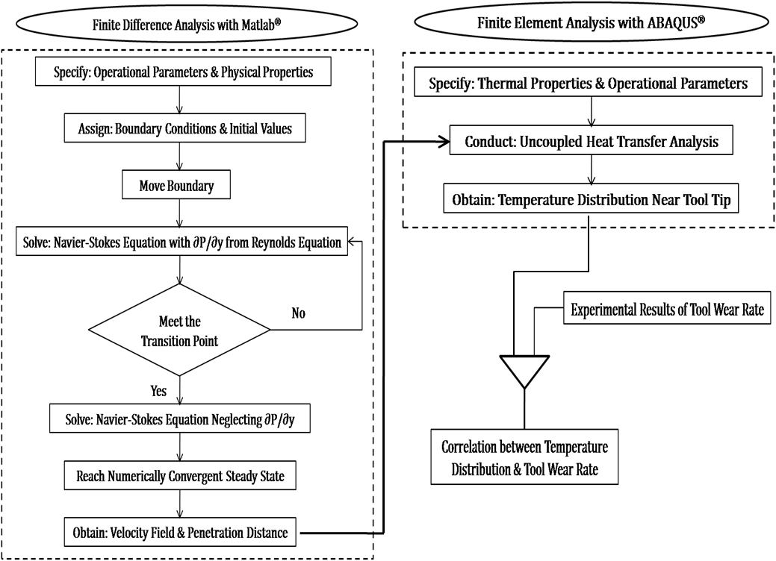

Slide 4
Finite Difference Analysis with Matlab®
Specify: Operational Parameters & Physical Properties
Assign: Boundary Conditions & Initial Values
Move Boundary
1st Trial Solve: Navier-Stokes Equation without ∂P/∂y
Calculate: 75% of the Peak Value of Penetration
Below the 0.05 Cut-Off
No
∂P/∂y Interpolation
Yes
2nd Trial Solve: Navier-Stokes Equation with ∂P/∂y from Reynolds Equation
Reach Numerically Convergent Steady State
Obtain: Velocity Field & Penetration Distance

